Slide 1
Group Project:
H-1B Visa Petitions 2011-2016

Slide 2







Our Team
Twinkle Jain
Nishita S
Nagaratna Y
Pushpalatha D
Sri Kiran Pramoda R

Slide 3
Problem Description:
The H-1B visa program is a category of employment-based, non-immigrant visas that allow US employers to hire foreign workers temporarily. To apply for an H-1B visa, a US employer must offer a job to a foreign national and submit a petition to the US immigration department. This program is widely used by international students who have completed their education in the US and wish to work in a full-time position. The H-1B visa program has been a topic of debate in recent years, with some arguing that it displaces American workers and others maintaining that it is necessary for filling gaps in the US labor market. The H-1B visa petition dataset contains information on H-1B visa petitions filed between 2011 and 2016, including details on employers, job titles, prevailing wages, and more.

Slide 4
Project Road Map
Data Pre Processing
Conceptual and Logical Design
Physical design and data loading
Insight Analysis
Data visualization

Slide 5
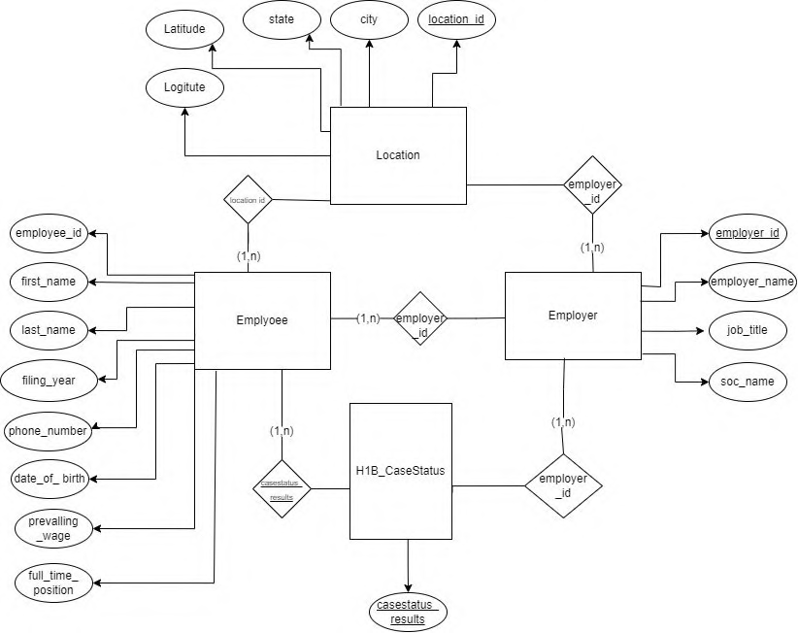

Conceptual Data Model
An employer can have more than one visa petition for different employees
Each Employer and Employee is given a unique ID
Each Employer can file visa petitions from multiple locations
Each employer can have multiple employee
Each location has multiple employee

Slide 6

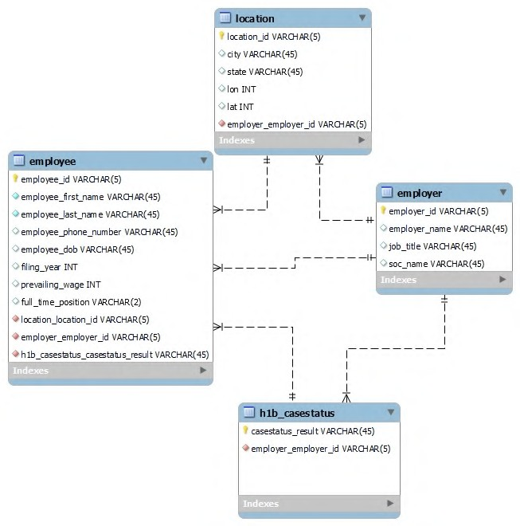
Logical Data Model
Parent | Child
Employer | Employee
Employer | Location
Employer | Case Status
Case Status | Employee
Location | Employee

Slide 7


Physical Data Model
with commands

Slide 8
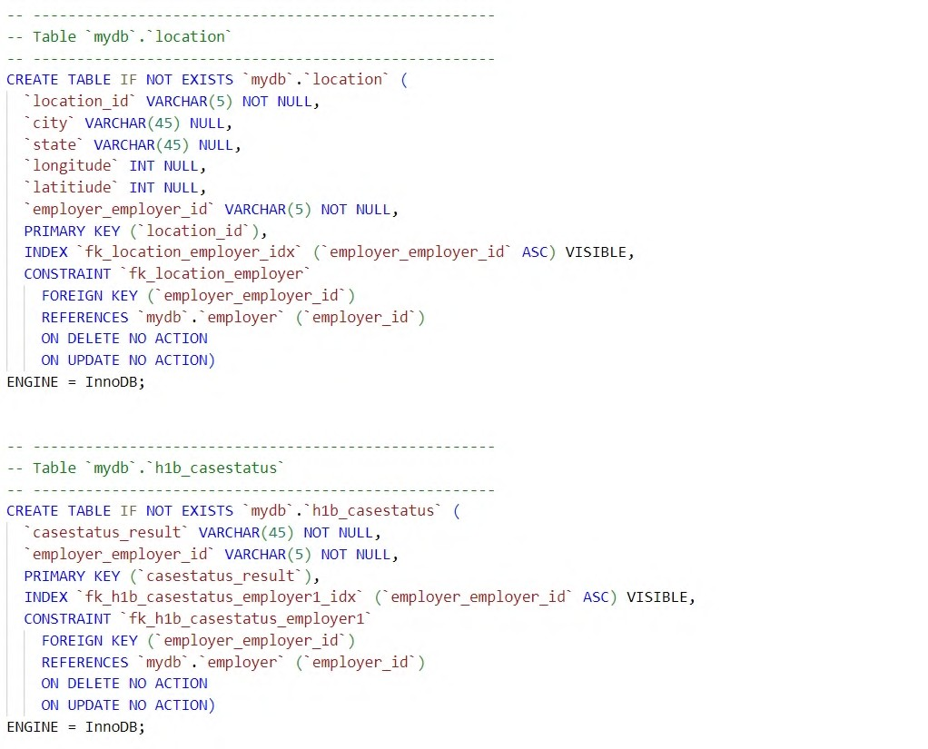
Physical Data Model
with commands

Slide 9


Physical Data Model
with commands

Slide 10
1. Which employer had the highest number of certified H1B visa petitions
2. Which employer had the highest number of H1B visa petitions filed 3 . In which year were the most H1B visa petitions filed
4. What was the average prevailing wage for H1B visa petitions that were certified/approved
5. What are the top 5 job titles held by employees for H1B visa petitions that were certified or approved
Insights Identified
Which state and city had the highest number of H1B petition filings between 2011 and 2016?
What are the top 5 cities and states with the highest number of H1B visa petition filings between 2011 and 2016
Among H1B visa petitions that were certified but later withdrawn from 2011 to 2016, which employer had the highest number of such petitions
Among H1B visa petitions that were certified but later withdrawn from 2011 to 2016, which 5 employers had the highest number of such petitions
Among withdrawn H1B visa petitions from 2011 to 2016, what was the average prevailing wage for the employees named in those petitions

Slide 11
Examined the dataset of selected H1B petitions and eliminated any duplicated records to prevent redundancy in our analysis.
Data loading concept used
01
02
Identified and removed repeating groups in accordance with the First Normal Form (1NF).
03
Detected any missing values in the dataset and implemented suitable measures to manage them.
04
Identified partial and transitive dependencies in the dataset and resolved them using normalization principles.
05
Eventually, we converted the data into a different format or structure as per the analysis that we intended to carry out.
Overall, the data cleaning process helped to ensure that the H1B petitions dataset was accurate, consistent, and ready for analysis in SQL

Slide 12
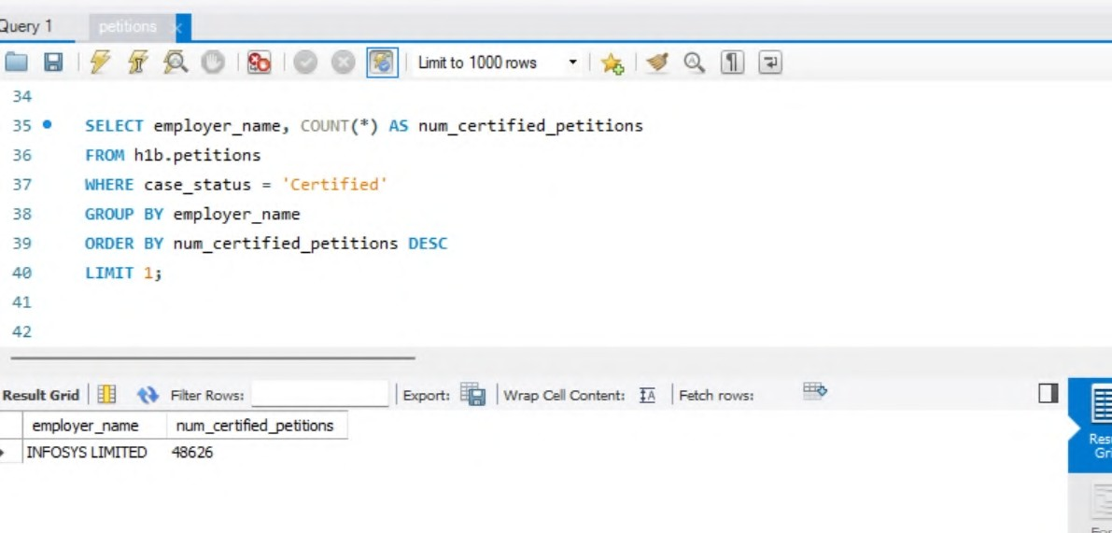
Insight-1
Script:
SELECT employer_name, COUNT(*) AS num_certified_petitions FROM h1b_petitions
WHERE case_status = 'Certified' GROUP BY employer_name
ORDER BY num_certified_petitions DESC
LIMIT 1;
Which employer had the highest number of certified H1B visa petitions

Slide 13


Slide 14
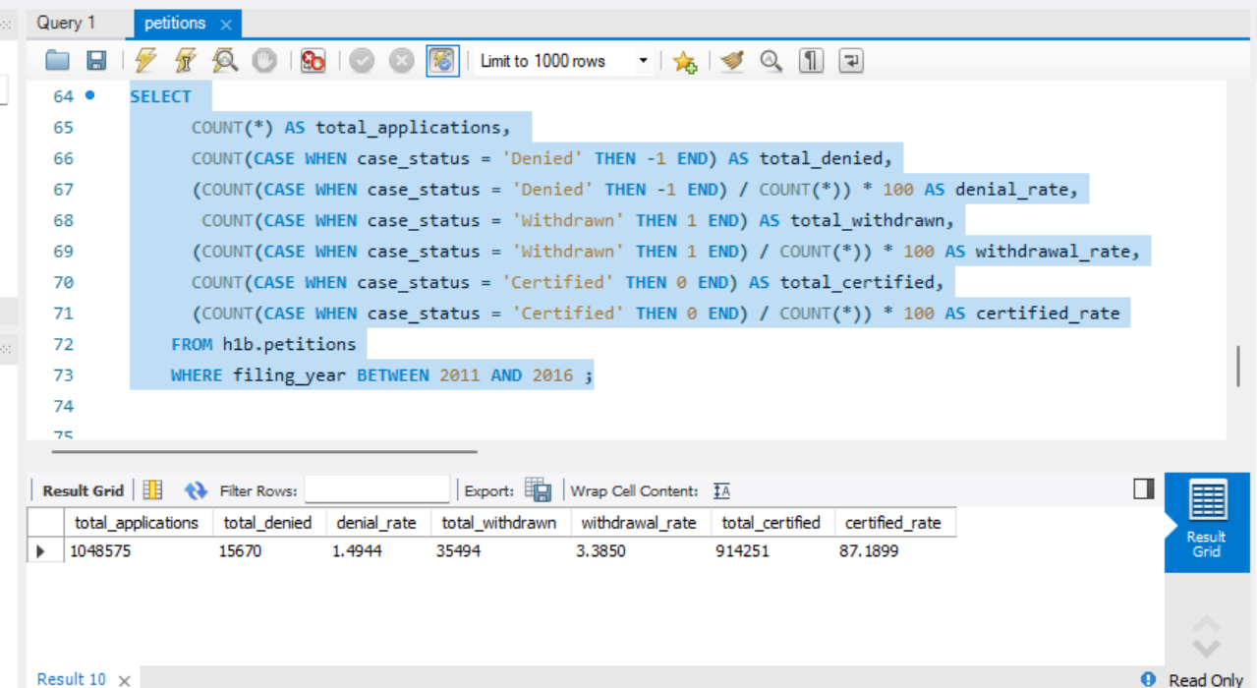

Slide 15
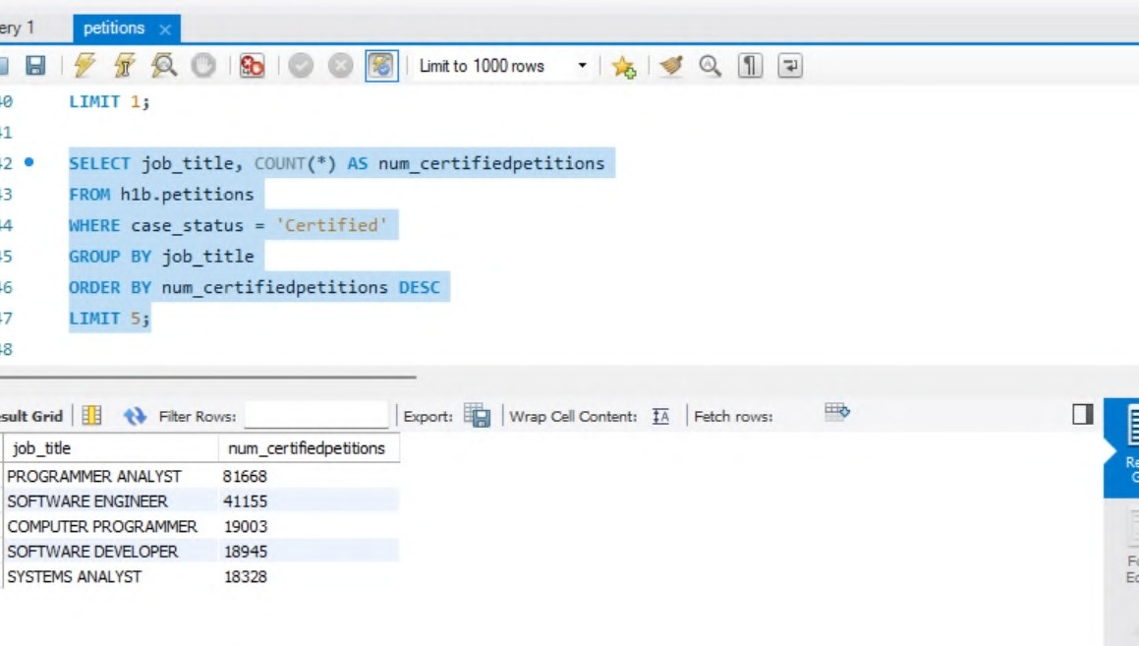
Insight-2
Script:
SELECT job_title, COUNT(*) AS num_certifiedpetitions FROM h1b_petitions
WHERE case_status = 'Certified' GROUP BY job_title
ORDER BY num_certifiedpetitions DESC
LIMIT 5;
What are the top 5 job titles held by employees for H1B visa petitions that were certified or approved?*

Slide 16
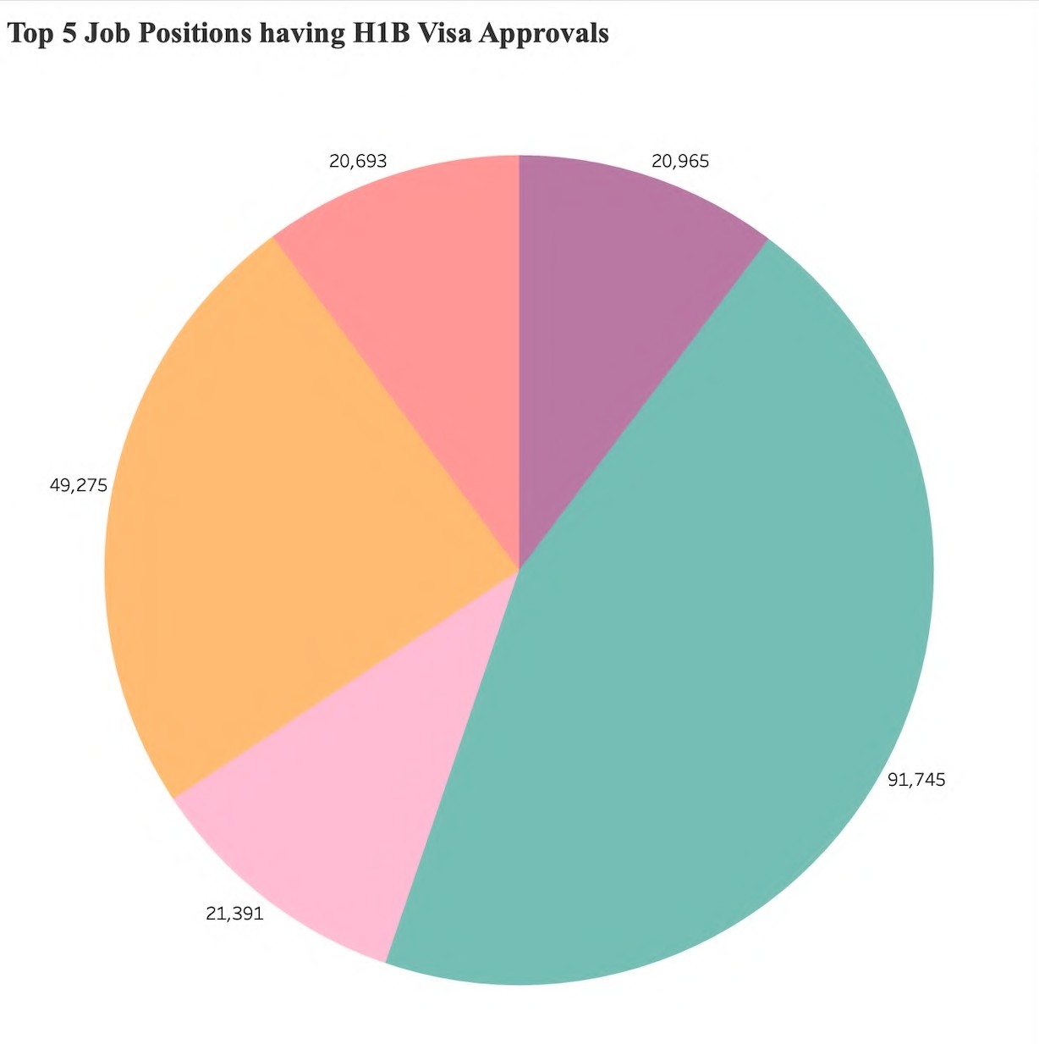
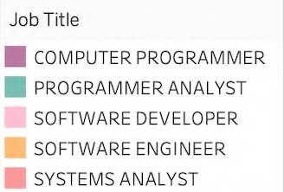
18,328
19,003
41,155
81,668
18,945

Slide 17
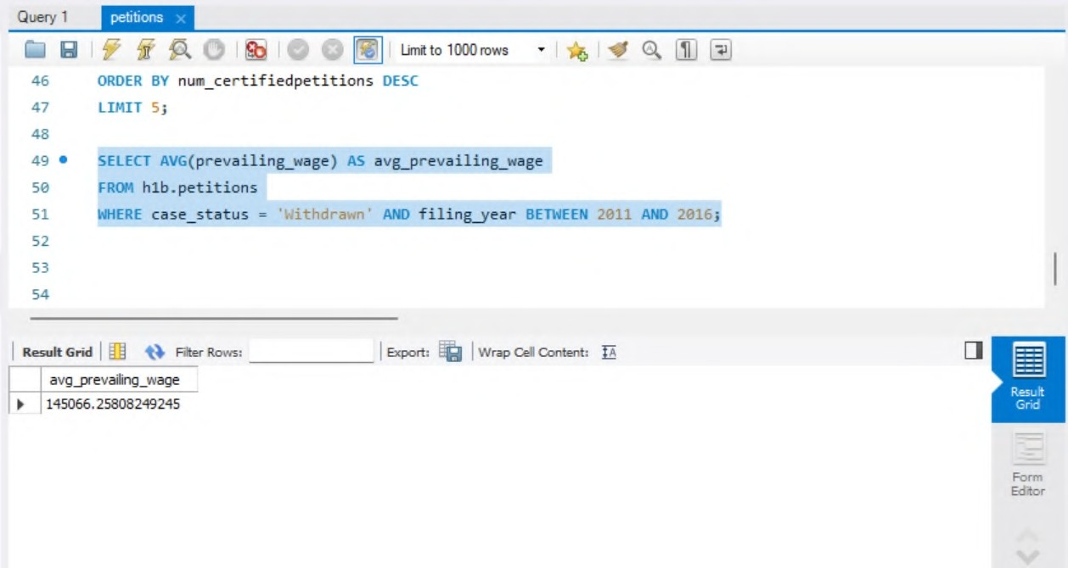
Insight-3
Script:
SELECT AVG(prevailing_wage) AS avg_prevailing_wage FROM h1b_petitions
WHERE case_status = 'Withdrawn' AND filing_year BETWEEN 2011 AND 2016;
Among withdrawn H1B visa petitions from 2011 to 2016, what was the average prevailing wage for the employees in those petitions

Slide 18
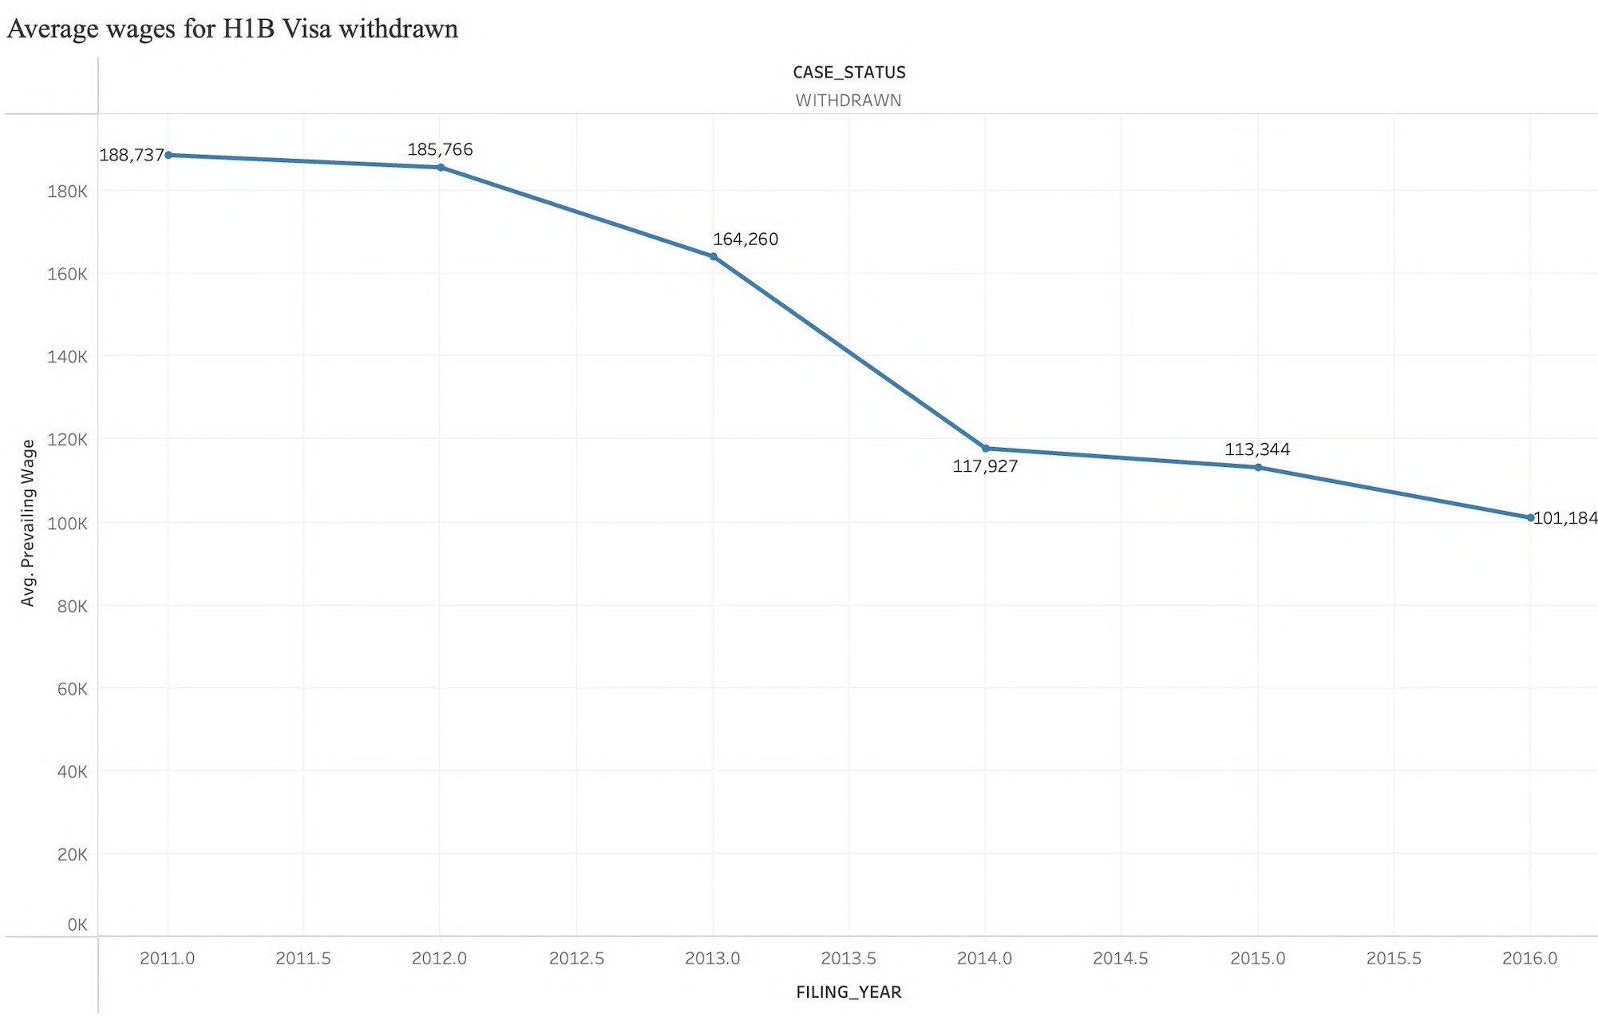

Slide 19
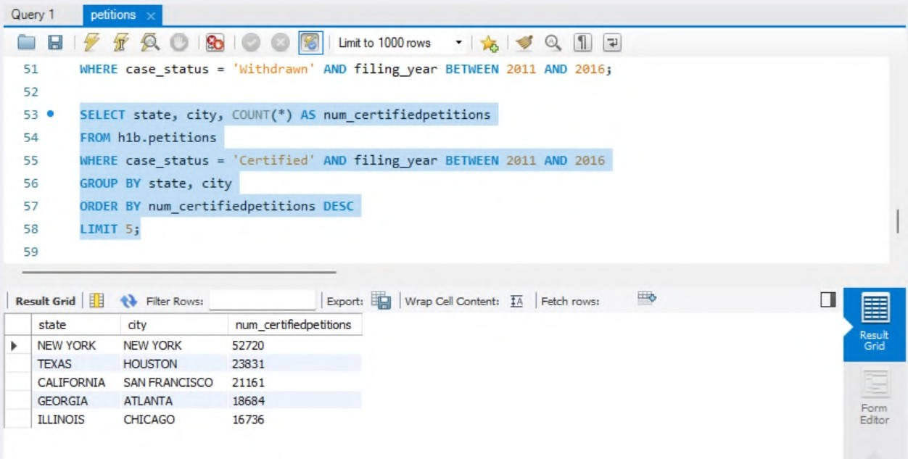
Insight-4
Script:
SELECT state, city, COUNT(*) AS num_certifiedpetitions FROM h1b_petitions
WHERE case_status = 'Certified' AND filing_year BETWEEN 2011 AND 2016
GROUP BY state, city
ORDER BY num_certifiedpetitions DESC LIMIT 5;
Among all certified H1B visa petitions filed from 2011 to 2016, where was the filing location for the top 5 states with the most approved petitions?

Slide 20
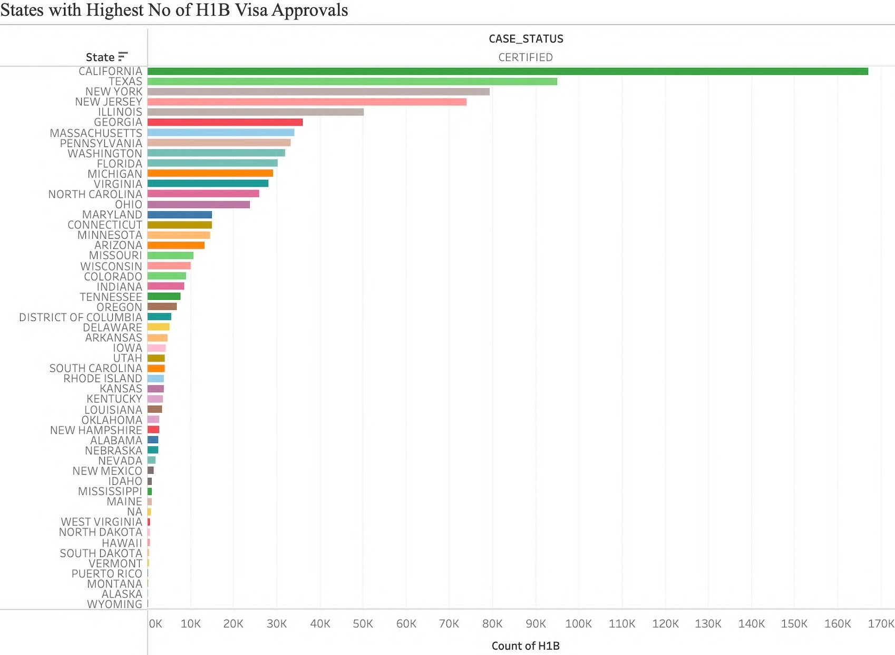

Slide 21

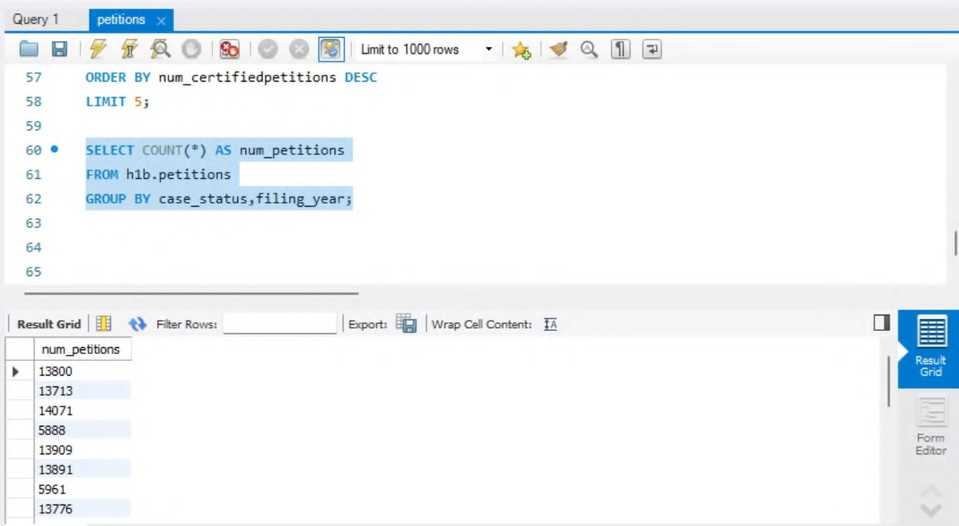

Insight-5
Script:
SELECT COUNT(*) AS num_petitions FROM h1b.sampledb_data
GROUP BY case_status,filing_year;
Case status of H1B visa's

Slide 22
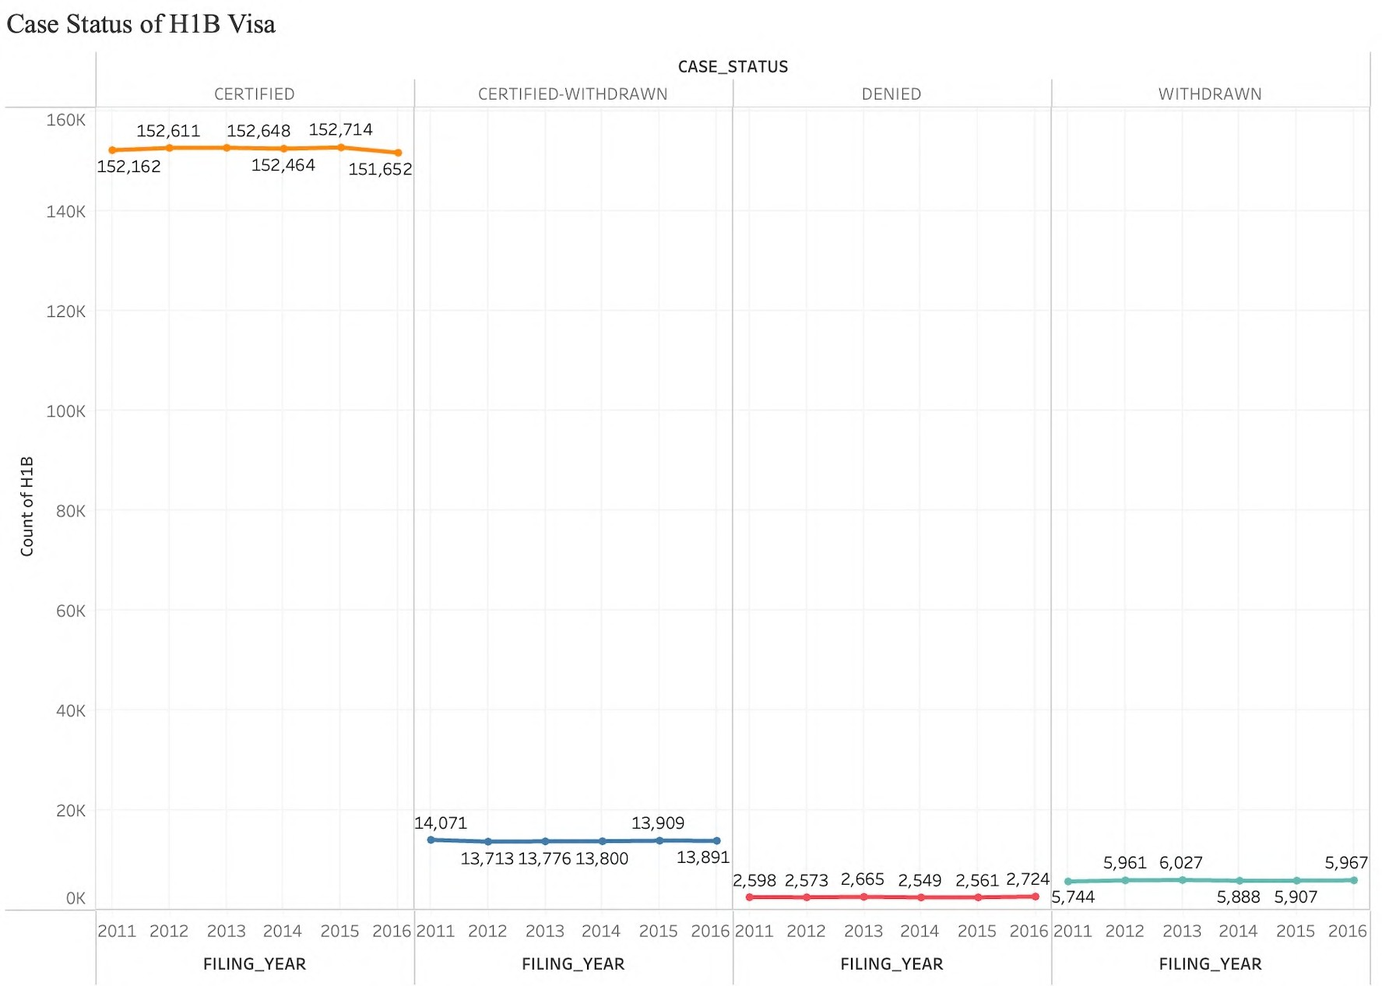

Slide 23
Conclusions
The year with the highest number of filed H1B visa petitions was 2013.
Between 2011 and 2016, 87.2% of H1B petitions were approved, while 1.5% were rejected and 3.4% were withdrawn.
Over 50% of H1B visa petitions are filed for full-time job positions.
The region with the highest number of filed H1B petitions was California, followed by Houston in Texas.
Out of all the employers considered, Infosys stood out as the company that filed the highest number of H1B petitions.

Slide 24


Slide 25
Data Source
https://www.kaggle.com/datasets/nsharan/h-1b-visa

